Slide 2
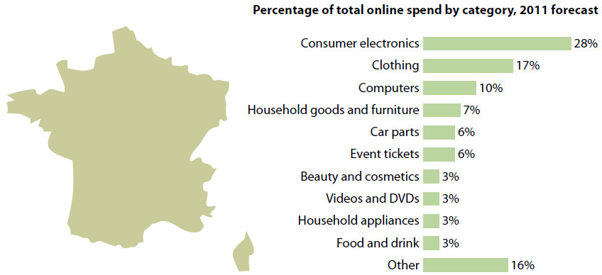
DID YOU KNOW… RETAIL IN FRANCE
Source: New@MarketIntelligence Blog:
Forrester: French Online Retail Overview, 2012

Slide 3


MARKET INTELLIGENCE
Stay informed about the latest news & trends from the online market!
Visit the zanox Market Intelligence Blog:
http://bit.ly/zxMI
Follow us: www.twitter.com/zxMI

Slide 4


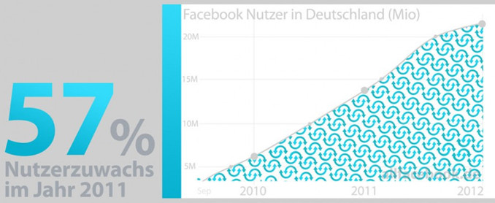
NICE TO KNOW ABOUT… FACEBOOK
Source: press release of t3n

Slide 5
EVENTS
01.02./02.02. M-Days 2012, Frankfurt
[congress with national and international experts of the mobile industry]
27.02./01.03. Mobile World Congress, Barcelona
[topic: connected customer, mobile apps, ….]
01.03. Affiliate NetworkxX, Munich
[zanox supports the great networking event]
14.03./15.03. Swiss Online Marketing, Zurich
[the trade fair for Affiliate Marketing, E-Commerce, Mobile Marketing, … ]
27.03./28.03. Internet World, Munich
[the e-commerce trade fair for Mobile & Social Media, Video & Affiliate Marketing]

Slide 6
WE ARE HIRING! Jobs Berlin (w/m)
Project Manager Global Sales Op.
Werkstudent Global Sales Op.
Commercial Director Sales
Database Specialists
Client Service Representative
Agile Test Engineers
Key Account Manager Advertiser
Scrum Master
Werkstudent Advertiser Sales
Praktikant Global Sales
more at www.zanox.com/jobs
Please remember our „Friends-recommend-Friends“-program

Slide 7
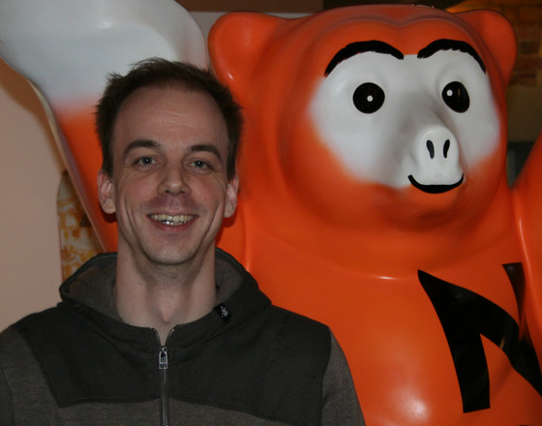
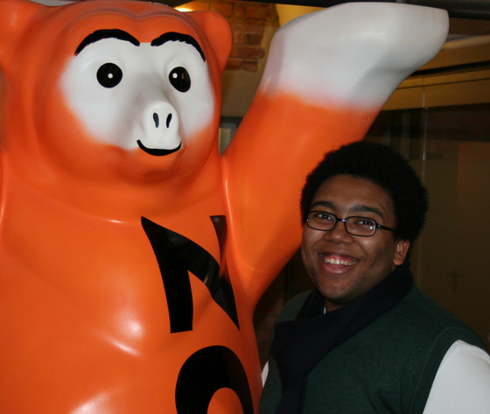
New Employees January
Fabian Bieker
Java Developer/NoSQL
Development
Jesse dos Santos
Intern Marketing

Slide 8
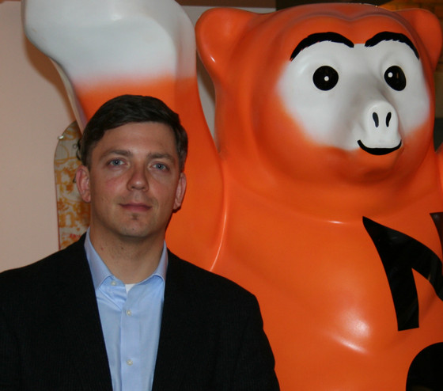
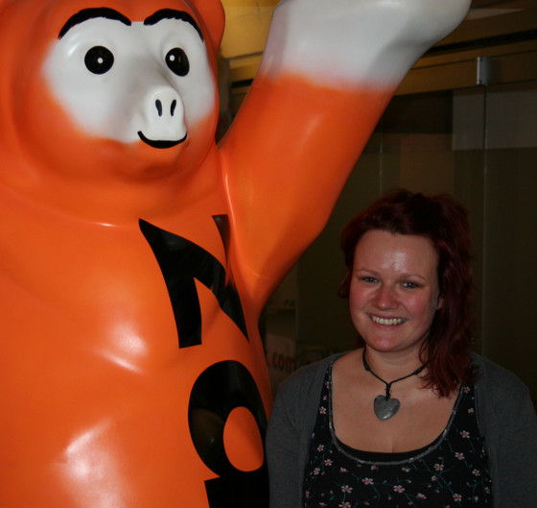
New Employees January
Christian Schäfer
Executive Assistant & Procurement Manager/ Finance
Kathrin Wilde
Werkstudent Sales Operations DACH

Slide 9
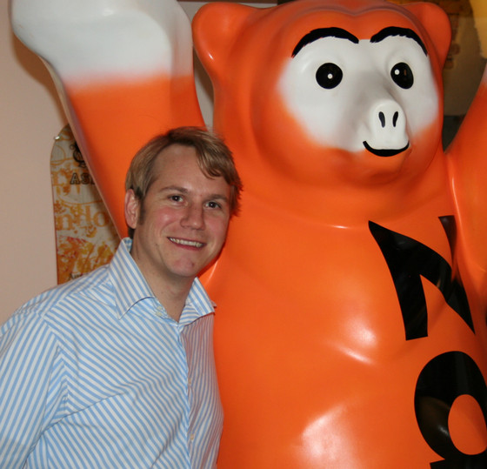
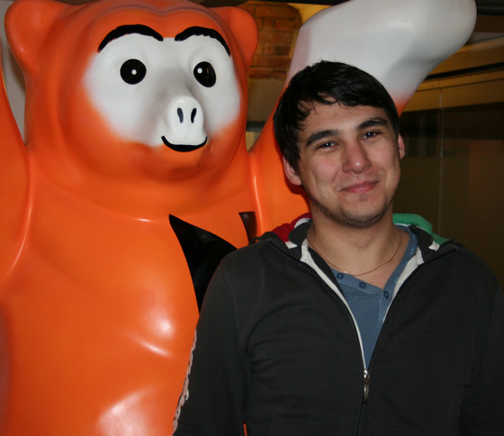
New Employees January
Michael Grigorev
Werkstudent
Sales – Advertiser Channel Consulting
Michael Hans
Key Account Manager
Sales – Advertiser Channel Consulting

Slide 10
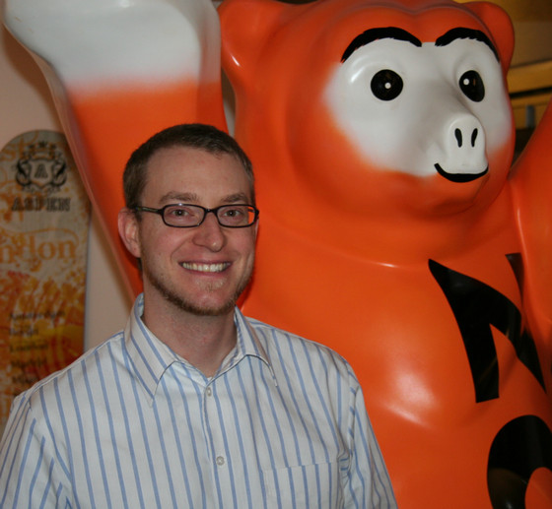
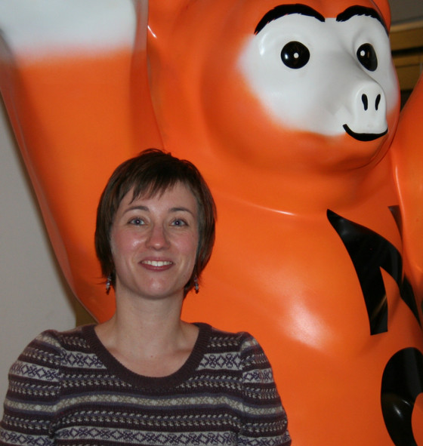
New Employees January
Sascha Möllering
Software Architect
Development
Stefanie Bröker
Key Account Manager
Sales – Retail/Travel

Slide 11

CONGRATULATIONS!
Birthdays of the months
Michaela Böhme (18.01)
Markus von Lepel (26.01.)
Please register your birthday (date only) in our wiki:
zx-wiki/display/zx/BIRTHDAYS

Slide 12
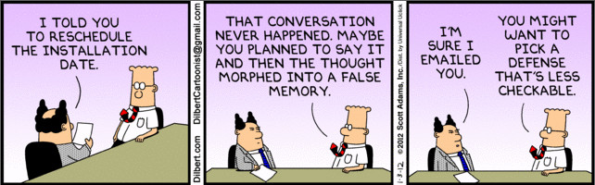
HOW TO…

Slide 13
campus.tv@zanox.com
Do you have more ideas and news for campus.TV?
Please send it to us!
We are pleased to get exciting news!
campus.tv@zanox.com

